Slide 1

Why and how to get to automated
transit and transportation faster
Ministry of Transportation Ontario
June 17, 2016 — Toronto
Bern Grush
Grush Niles Strategic
Notes:
We hear a lot about autonomous vehicle

Slide 2
Questions
When will fully automated vehicles arrive?
What infrastructure will be needed? Be best?
Will the ownership model change significantly?
Will “Access Anxiety” kill the household market for automated vehicles?
Will automation mean more or fewer VKT?
Will the Zahavi/Marchetti budgets hold?
Will drivers make “rational” choices (this time)?
Can we rely on the robotaxi simulations?
What if robotics make travel cheaper?
Will Silicon Valley change social fundamentals of automobility?
Isn’t Attention the real prize?
How can we achieve “Intended Consequences”?
Can robotics reduce the “Wicked Problem” of automobility?
In what order will transport segments change?
Will governments learn how to use Behavioral Economics?

Slide 3
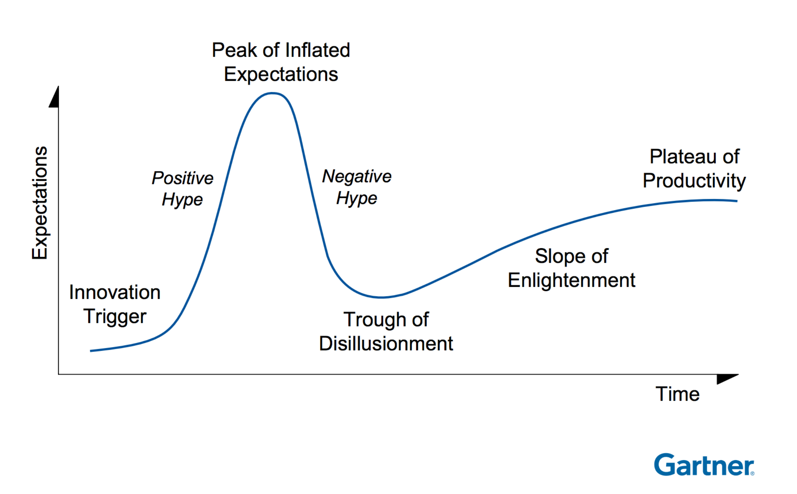
Gartner Hype Cycle for Autonomous Vehicles
2015
2014
2016
-2025
?
2013
2012
2010
More than 10 years to Plateau of Productivity for AV
5 to 10 years to Plateau of Productivity for AV
Notes:
Starting in 2010 Gartner began predicting the rise in hype for the Autonomous Vehicle.
CLICK: Over each of the next five years Gartner tracked this to its peak in 2015. Indeed, it is easy to find evidence that the Negative Hype has already started and that we are seeing dampened excitement and growing caution.
This happens to all technologies, and there seems no doubt that the AV will pull out of this. Gartner says 5 to 10 years.
CLICK: My money is on ten.
I will come back to a solution to this setback in expectations.

Slide 4

Are our Cities ready for AVs?
Building designs
Curbs
Driveways
Landscape architecture
Living patterns
Pedestrian safety
Planning law
Roadway design
Sidewalks
Sociology
Speed limits
Streets
Transportation engineering
Urban layouts
Urban networks
“There are a lot of unknowns and divergent scenarios.” Car-sharing could cut down traffic, allowing for smaller streets and parking lots. Or, cars could become cheaper than ever and stay in circulation, increasing congestion, Marshall says. “The weird irony of driverless cars is that more people might drive.”
http://www.wired.com/2016/04/american-cities-nowhere-near-ready-self-driving-cars/
Notes:
Uniform law across regions, states, nations?
CLICK We assume AV are safer, because robots can drive better than most humans. Will industry or government standards and certifications be developed to assure that?
CLICK You want manufacturer to be liable since either SW is running the vehicle; BUT you want the owner to be liable so that owner keeps vehicle maintained and untampered
Imagine a robo-taxi fleet owner with 100,000 vehicles in your city — say Uber in 2030…
CLICK Security
CLICK There is money in Infotainment; and there is distraction. Distracted driving is increasing.
CLICK!
In Ontario:
http://www.citynews.ca/2015/09/01/rules-of-the-road-stiffer-distracted-driving-fines-take-effect/

Slide 5

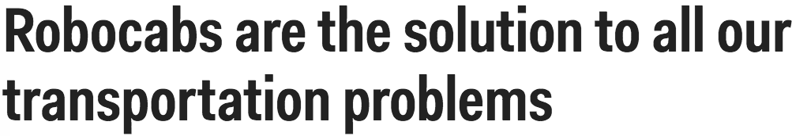
Will we consume trips or cars?
“…self-driving cars paired with [TNCs] such as Uber will pretty much kill the need to own a car in 25 to 30 years”
Jamais Cascio, futurist, senior fellow at the
Institute for Ethics and Emerging Technologies
“If you’re financially smart and living in the city and you don’t need a car to get to work, you’re insane to own one,” Chase says.
Notes:
Will we consume cars or kilometers?
There are many who claim, “no one will own a car”. That is an unproven assumption.

Slide 6
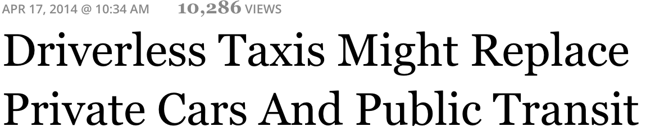
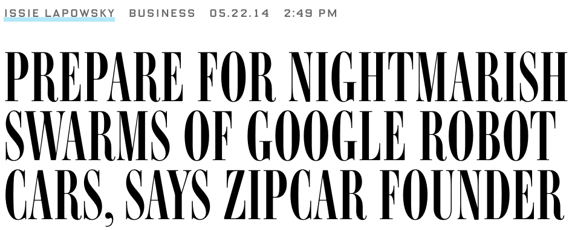

Experts are alarmed
Self-driving cars will reduce the demand for public transit

Slide 7
How will AVs mix with the existing fleet?
“…just as the early 20th century had a chaotic mix of horses and cars sharing roadways, there will be setbacks as we mix AVs and conventional vehicles over the next couple of decades.”
Bob Denaro, in ITS International March/April 2016
Denaro is a member of the USDOT’s ITS Program Advisory Committee, and chairs TRB’s Joint Subcommittee on Challenges and Opportunities for Road Vehicle Automation.

Slide 8
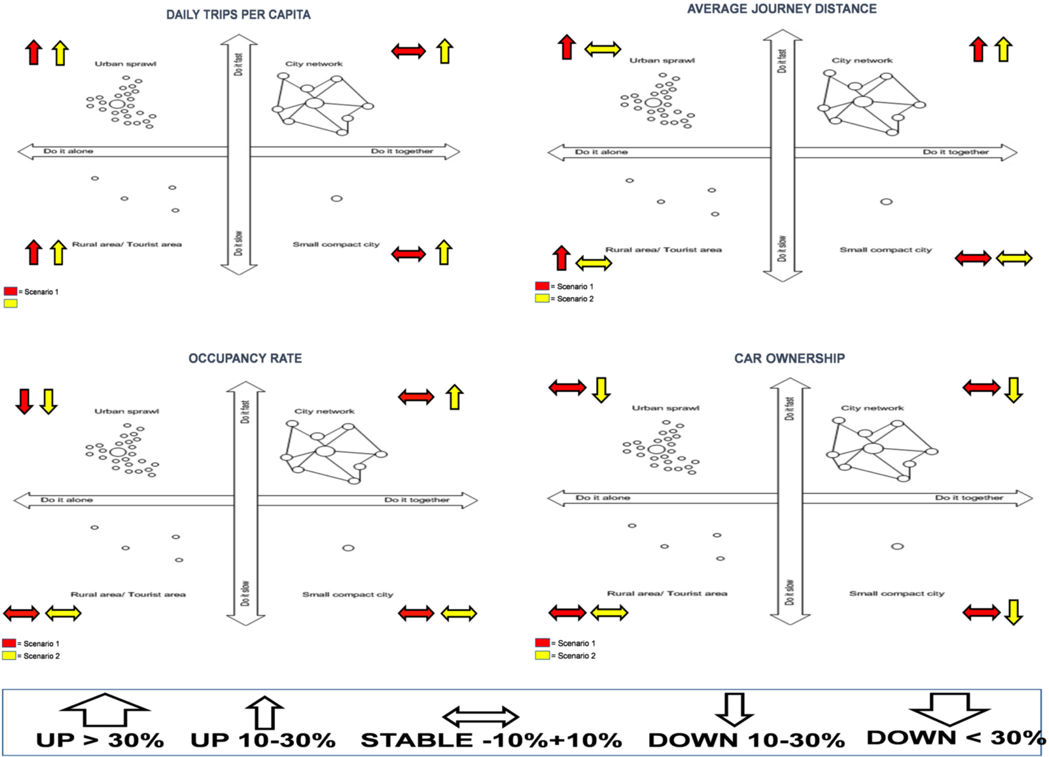
CityMobil2 – Survey of 89 experts
More
trips
Suburban
Urban
Suburban
Urban
Longer journeys
Trips
Distance
Rural
Village
Rural
Village
Fewer occupants
Suburban
Urban
Suburban
Urban
Fewer owners
Occupancy
Ownership
Rural
Village
Rural
Village
Household dominant scenario
Fleet dominant scenario
CityMobil2 - D27.2 Results on the on-line DELPHI survey
Notes:
The arrows (red for scenario 1 and yellow for scenario 2) represent for each key variable both the direction (increase, decrease or stability) and the intensity (bigger arrows for > 30% change in the base variable, smaller arrows for a change between 10% and 30%) of the likely change, according to the most frequent responses to the survey (modal values).

Slide 9
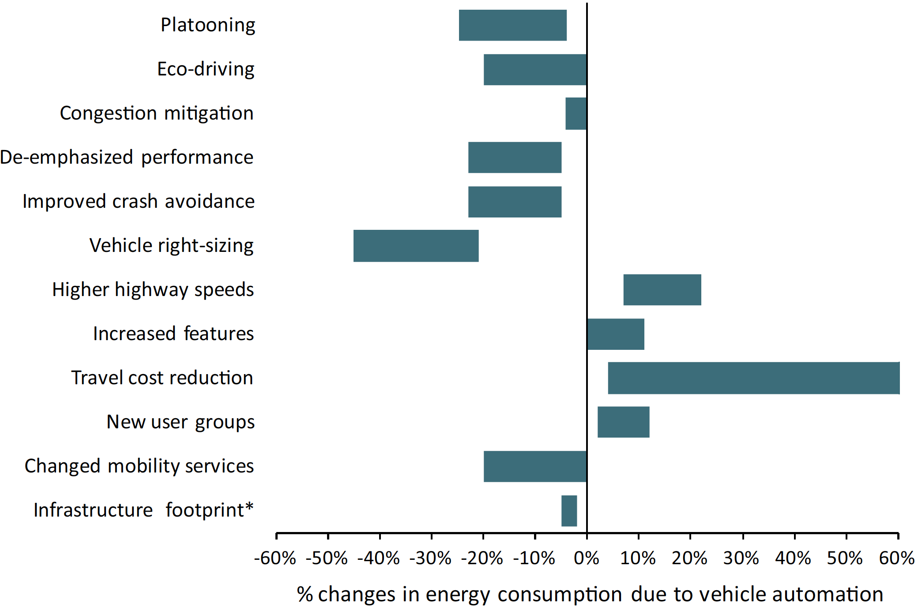
Energy Uncertainty
Wadud, et al 2015
Better routing
Brown, et al 2014
Help or hindrance? The travel, energy and carbon impacts of highly automated vehicles
Less parking circling
An analysis of possible energy impacts of automated vehicles, road vehicle automation.
Higher occupancy
Cycle smoothing
Enabling electrification
More travel
Faster travel
Travel by the underserved
Notes:
Not only do study results differ from each other, but each study shows considerable variability within a single study. Each researcher may also consider different variables…
Here is a case that one researcher considered electrification and another did not. One might guess that all the extra travel could easily offset all the gains from electrification. But then there is an unconsidered (unweighted) social and wealth value of more travel. How can that be considered in the same models?
Cycle smoothing seems to be similar to eco-driving. Is this an overlap in assessment?

Slide 10
Questions
When will fully automated vehicles arrive?
What infrastructure will be needed? Be best?
Will the ownership model change significantly?
Will “Access Anxiety” kill the household market for automated vehicles?
Will automation mean more or fewer VKT?
Will the Zahavi/Marchetti budgets hold?
Will drivers make “rational” choices (this time)?
Can we rely on the robotaxi simulations?
What if robotics make travel cheaper?
Will Silicon Valley change social fundamentals of automobility?
Isn’t Attention the real prize?
How can we achieve “Intended Consequences”?
Can robotics reduce the “Wicked Problem” of automobility?
In what order will transport segments change?
Will governments learn how to use Behavioral Economics?

Slide 11
Evolution
“Automation of driving is seen to be a continuum, with the distinction between driver assistance and self-driving as an evolution in design and production.”
Automated Vehicles: Implications for the Insurance Industry in Canada
“Self-driving cars remain a long way from commercial reality. They are suitable only for tightly controlled road environments, at slow speeds, and face a regulatory minefield.”
Carlos Ghosn in Gordon-Bloomfield, “Nissan Changes Expectations, Timeline for Autonomous Drive Technology.”
or
Revolution

Slide 12
Evolution is technical
SAE standard levels of automation
Driver
Assistance
Level 1
Partial
Automation
Level 2
Conditional
Automation
Level 3
High
Automation
Level 4
Full
Automation
Level 5 *
* SAE
Semi-
automated
Automated

Slide 13
Technical is difficult
Driver
Assistance
Partial
Automation
Conditional
Automation
High
Automation
Full
Automation
Automated Driver Assistance systems
now
2070
Constrained
Conditions
Anywhere

Slide 14
Revolution is social
Full
Automation
High
Automation
Consumer
Household
Robocab
Transit
complexity
Conditional
Automation
Driver
Assistance
Partial
Automation
time

Slide 15
Social is very difficult
Full
Automation
Worse before better
High
Automation
MORE
Parking
Congestion
Distraction
Sprawl
LESS
Parking
Congestion
Distraction
Jobs?
Safer
Conditional
Automation
Driver
Assistance
Partial
Automation
Moving to a robotic shared fleet is a Wicked Problem

Slide 16
Zahavi/Marchetti budgets
1 hr
12%
Time
Money
Non-travel
Non-travel
Saved time? ➔ More trips
Saved money? ➔ More vehicle
These anthropological constants bias responses and preferences relative to everything about automobility:
Congestion
Speed
Buses
Tolling
Parking accessibility
Vehicle ownership
Gas prices
Bikes
Notes:
Yacov Zahavi’s observations, furthered by Cesare Marchetti, are important social invariants for automobility. Humans seem to be comfortable with traveling about an hour/day and spending about 12% of their income on transportation. The time budget has been a factor since the Neolithic, as we settled into agriculture. While statistical simplifications for modeling, these alsohelp predict our responses to congestion, speed, buses, vehicle ownership even parking accessibility. Our travel budget grows with wealth, hence GDP drives automotive ownership increases to plateau around 800/1000, country-by-country.
Today, owning a personal vehicle is within reach of the budgets of more and more people, hence the extant world-wide vehicle population is still growing.
“The identification of stable daily travel time "budgets" brought home to Zahavi the importance of travel speeds. He realized that travelers did not save time as a result of increases in travel speed, but that they applied the time saved from some trips for additional travel. This led him to explain the resistance of travelers to switch from private cars to slower public transport modes. This resistance, described by too many as a "love affair with the motor car", he explained as unwillingness to lose trips, because of the activities associated with them. This led him to conclude that public transport could attract significant numbers of passengers from private cars only by offering higher door-to-door speeds, as it does for many trips in cities such as London, New York and Paris.
http://www.surveyarchive.org/zahavi.html
https://en.wikipedia.org/wiki/Marchetti%27s_constant

Slide 17
Level 3 Household: significant sales
How long until peak? (2030-2035?)
Competition from MaaS / TaaS?
Sprawl?
Mixed traffic: household L3 and robocab L5
Interim dystopia until L5 utopia?
Level 5 Household: No sale in 2020s
© Grush Niles Strategic
Not yet a “Whole Product”
Vehicle
Infrastructure
Regulation
Insurance
Acceptance
Access Anxiety
Range Anxiety
slowed EV penetration
Access Anxiety will hamper AV penetration

Slide 18
Access Anxiety
“A critical AV leverage available to local governments and transit agencies is Level 5 Access Anxiety.
This is a bigger market issue than user uncertainty, cost, and fear.
Autonomous transit and robocabs applications provide the advantages of Level 5 automation two decades sooner than household ownership.”
Grush, Niles, End of Driving

Slide 19
Access Anxiety
Full
Automation
High
Automation
Access Anxiety (Barrier and Gateway) 2030-2070?
Consumer
Household
Robocab
Transit
Conditional
Automation
Driver
Assistance
Partial
Automation

Slide 20
Access Anxiety Switchover
After 2030…
“There will be fewer restrictions on where [L5] cars can operate—instead there'll be more rules on where manual cars can be driven.”
http://www.recode.net/2016/5/16/11635628/self-driving-autonomous-cars-timeline

Slide 21
What’s a Wicked Problem?
Indeterminant formulation
Indeterminant solution
Non-solveable
Irreversible
Unique
Notes:
Wicked Problems have five key characteristics....
Indeterminacy in problem formulation—the precise formulation of a wicked problem as a problem with unique and determinate satisfaction conditions is virtually impossible because the values and interests of concerned and affected parties are diverse, often in conflict with one another, and change over time and across generations.
Non-definitiveness in problem solution—a rigorous and ultimate solution to a wicked problem with definitive results is unattainable because neither the problem nor the repercussions of its solution are determinate. The latter is best described by Rittel and Webber as “The full consequences [of a solution] cannot be appraised until the waves of repercussions have completely run out, and we have no way of tracing the waves through all the affected lives ahead of time or within a limited time span” (Rittel & Webber, 1973, p. 163).
Non-solubility—wicked problems can never be solved because of the first two characteristics. Unlike “tame problems” that are determinate with clear goal(s) and a definite set of well-defined rules (like those in mathematics, engineering, and chess), and are thus ultimately soluble (eliminable), wicked problems may be suppressed or even overcome, but cannot be eliminated. In different and often more wicked forms, they will recur. Therefore, “[a]t best they are only re-solved—over and over again” (Rittel & Webber, 1973, p.160).
Irreversible consequentiality—every implemented solution to a wicked problem is consequential, often triggering ripple effects throughout the entire socio-ecological system that are neither reversible, nor stoppable. Large scale ecological projects (e.g., greenways, parks, reservoirs, natural reserves, wild life habitats, and riparian buffers), public works projects (e.g., freeways, airports, dams, and subways), and implemented environmental policies (e.g., the Clean Air Act in the United States, and the Chinese national policy of cross-region water resources transfer—“Nan Shui Bei Diao”) all “leave[s] ‘traces’ that cannot be undone” (Rittel & Webber, 1973, p.163).
Individual uniqueness—despite likely similarities among wicked problems, there always is one or more distinguishing property of overriding importance that makes an individual problem and its solution(s) essentially one-of-a-kind. There are therefore no classes of wicked problems, nor immediately transferable solutions.
Because of these characteristics, Rittel and Webber argued that wicked problems are innately resistant to any tame formulations of scientific analysis and linear protocols for professional practice, defying the conventional approaches and skill sets of planning, management, and policy-making.
From: "Working with wicked problems in socio-ecological systems: Awareness,acceptance, and adaptation"

Slide 22
Approaches to Wicked Problems
Authoritarian
  Few stakeholders = lower complexity
  Fewer perspectives = poorer solution
Competitive
  Weigh and choose
  Lower knowledge sharing; poorer solution
Collaborative
  Shared understanding of problem
  Long discussion to get to imperfect solution

Slide 23
Infrastructure readiness
One component of this wicked problem
Driver
Assistance
Partial
Automation
Conditional
Automation
High
Automation
Full
Automation
now
?
?
Constrained
Conditions
Anywhere

Slide 24
Infrastructure readiness
Semi-
Automation
Level 3
Constrained
Automation
Level 4
Full
Automation
Level 5
2020
2020
2060
Evolution
Household
Driver in
Little to do
Revolution
Robo transit
Robo taxi
Infrastructure incl fleet
Government & P3
Post-revolution
Private
Public
P3
Driver out

Slide 25
Evolution
Automated
Driver
Assistance
Systems
Household
Consumer
Models
Showroom
More cars
More parking
More congestion
More sprawl
Feature Creep
Big Auto
Attention is the problem
More of the
20th Century
Majority
direction
Silicon Valley
Attention is the prize
Less of the
20th Century
Hopeful
direction
Revolution
Fewer cars
Less parking
Less congestion
More sprawl
Public service
Robo taxi
Robo transit
Full Automation
No user control
This will not happen by accident…

Slide 26
Attention is the battle ground
Critical, non-renewable resource for
  Safety
    Inadequate attention causing rise in fatalities
  Productivity
    Promise to reduce the effective cost of congestion
  Consumption
    Data is really about marketing
  Social Media
    This will grow as an Attention Hog

Slide 27
Automobility and Attention
The automobile pays the greatest dividends in attention when:
  No congestion
  Free/convenient parking
  Wide, unblocked lanes
  Preferential signals
  No bikes
  Well-behaved pedestrians
  No social media devices
  Etc.
This peaked long ago
  Now severely compromised
  Services that restore any if this are in demand

Slide 28
Automobility and Attention
The automobile now pays declining dividends in attention:
Value of automobile in urban environments is severely compromised
  It’s not just about “time lost”, but how you can spend attention during travel
Services that restore attention’s dividends are in demand
  Parking finders
  Navigators
  Uber
  Convenient transit
  WiFi on Transit
  Service aggregator apps
  MaaS

Slide 29
Access to mobility
Full Ownership
Most private and expensive option. Least flexible for vehicle and ride access. Same as now.
Fractional Ownership
Buy into a brand fleet, neighborhood fleet, affinity fleet, employer fleet. Compromise for privacy, flexibility, cost.
Maximizes sharing values. Private ownership.
Robo
taxi
Corporate (or P3) fleets ownership; maximizes vehicle flexibility and access flexibility. Maximizes trickle-down potential.
Mobility
as a Service
P2P
sharing
Robo transit
Potential to maximize transportation equity and environmental justice. Municipal or P3 ownership. Includes Robo taxi format.
Maximizes ride flexibility. Minimizes cost. Hybrid ownership.
P2P sharing, Robo transit, Robo taxi would be subsets.
Level 4
Level 5
Notes:
All access models need manufacturing and create manufacturing jobs. Lowering cost per PKT with shared models means more PKT. More PKT means more vehicles. Manufacturing is in win-win, and need to anticipate which vehicles are best to make. Society is in win-win only to the degree that everyone has access, livability is maximized and the environment is protected.

Slide 30
Conflict of Interests
Make
Cars
More vehicles
will be needed (replacement for high-wear and for new participants). Innovate or add
auto software.
SOCIAL FOCUS
Transport equity
Urban livability
Environment
Job access
Opportunity
Attract growth
Conflict of interest
COMMERCIAL
Profit
Attention
Loyalty
Data
At
Risk
Automate
Cars
Excitement, anticipation, new consumer market, new value, high innovation.
Win-
Win
Regional
Transportation
Facing exponential
tech change & large
multinational players
& rising expectations
Sharing
Economists
Deploy
Cars
(e.g. TNCs)
P3s
Fill the gap left by municipalities. About operational optimization and service innovation, rather than vehicle innovation.
Notes:
All access models need manufacturing and create manufacturing jobs. Lowering cost per PKT with shared models means more PKT. More PKT means more vehicles. Manufacturing is in win-win, and need to anticipate which vehicles are best to make. Society is in win-win only to the degree that everyone has access, livability is maximized and the environment is protected. Without equity-oriented governance, robotics will not improve social metrics in a city.

Slide 31
Autonomous Transit
“The potential for automated and connected buses, streetcars, and subways has been largely absent in [transit] planning and is not anticipated over the next 10 years.”
Automated Vehicles: Implications for the Insurance Industry in Canada, p.45

Slide 32
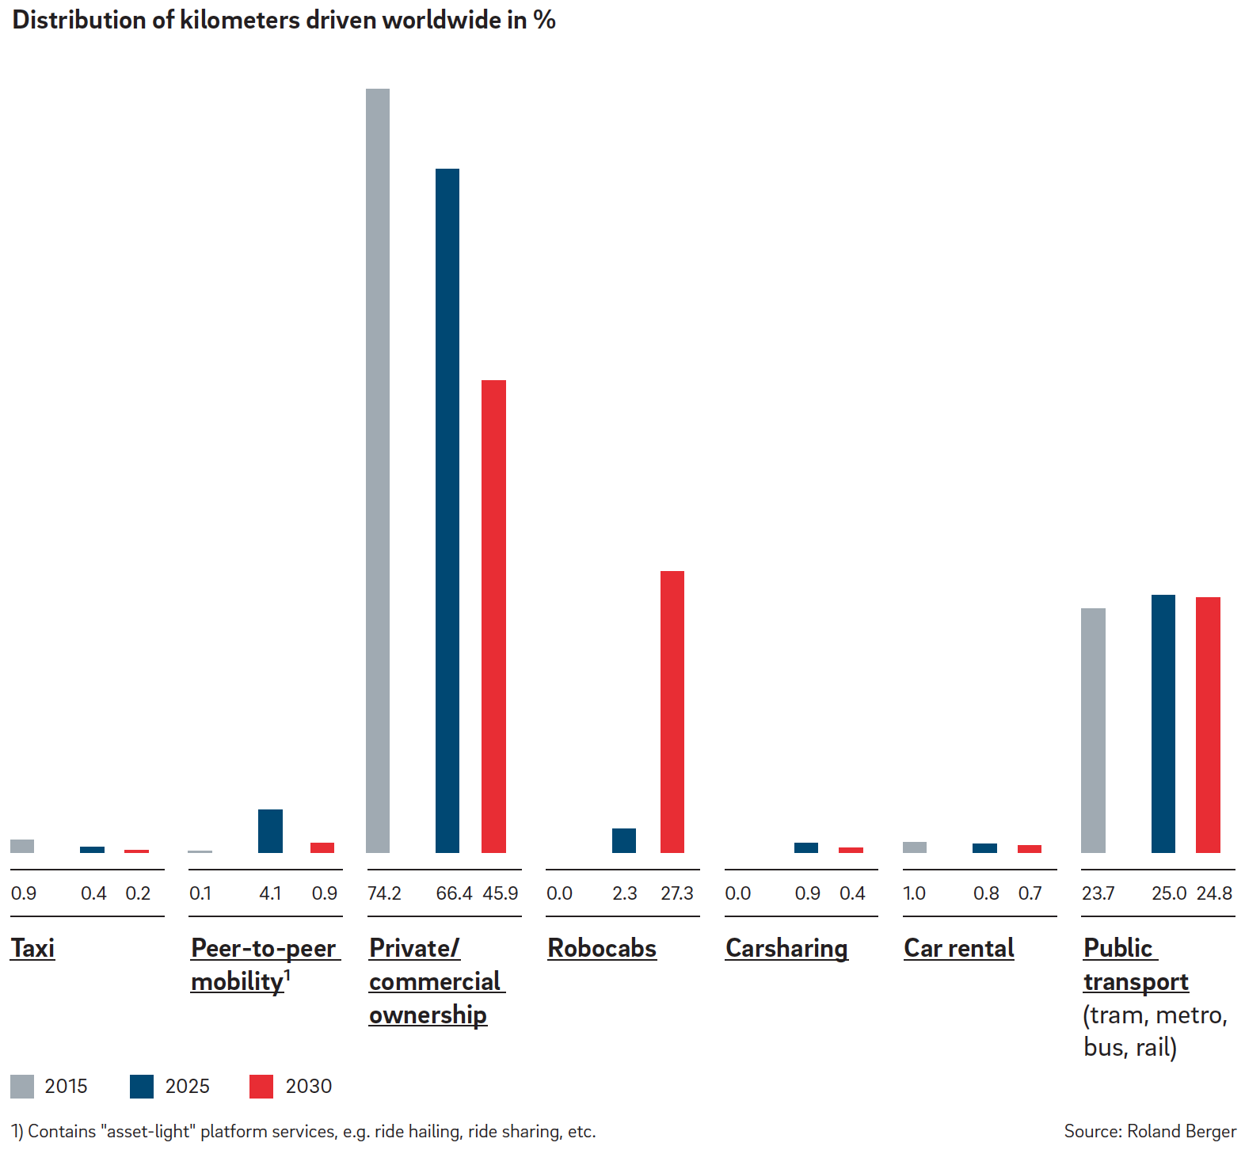
Roland-Berger
© Grush Niles Strategic
Notes:
Note re today
taxi less than 1%
Uber 0.1%
Rental 1%
carsharing less that 0.05% on half of 1/10th of a percent
Losers taxi 0.7 cars 28.3. Mostly robotics takes from cars.
Note 27% of VKT cannot be possibly be robocabs by 2030. That be ~10T km: 3Tmi * 1.6 (km) * 2 (doubling time) *4 world * 0.27 robocab = 10T. Even with no growth in VKT it would be 5T
At 110000km/veh/yr (5x current US household rate) we’d need and extant 75M robocabs by 2030. In 2012 60M cars built worldwide. It takes 3 years from concept to manufacture for a new vehicle.
April 8 2016
Bern, thanks for your note and interest in our study. Indeed, the robocabs we refer to in our study are based on SAE level 5.
Your general understanding of the values mentioned in our study and the implications you derived is correct. Our assumption for global VKT in 2015 is approx. 23 trillion, with North America (US and Mexico) accounting for approx. 28% (6.5 trillion VKT), and which is roughly in line with your indication below. Based on a detailed historical analysis of the VKT development per region (i.e., we differentiated between developed and emerging markets and the current position of each region along the curve to predict future growth rates, as scientific research has shown that there is no linear development across all regions), we foresee a global increase in VKT between 2015 and 2030 of approx. 35%. Hence, we predict approx. 8.5 trillion VKT (0.27 x 23 x 1.35) to be traveled by robocabs in 2030.
Marc Winterhoff

Slide 33
Robo VKT 27% by 2030
Cars
drop
-28.3
Robotics
rise
+27.3
Transit
Flat
+1.1
Uber
peaks,
fades
+0.8
4100% peak
82% fall
Taxis
die
-0.7
78% drop
Carshare
peaks,
Fades
+0.4
Rental
Fades
-0.3
Notes:
Note re today
taxi less than 1%
Uber 0.1%
Rental 1%
carsharing less that 0.05% on half of 1/10th of a percent
Losers taxi 0.7 cars 28.3. Mostly robotics takes from cars.
Note 27% of VKT cannot be possibly be robocabs by 2030. That be ~10T km: 3Tmi * 1.6 (km) * 2 (doubling time) *4 world * 0.27 robocab = 10T. Even with no growth in VKT it would be 5T
At 110000km/veh/yr (5x current US household rate) we’d need and extant 75M robocabs by 2030. In 2012 60M cars built worldwide. It takes 3 years from concept to manufacture for a new vehicle.
April 8 2016
Bern, thanks for your note and interest in our study. Indeed, the robocabs we refer to in our study are based on SAE level 5.
Your general understanding of the values mentioned in our study and the implications you derived is correct. Our assumption for global VKT in 2015 is approx. 23 trillion, with North America (US and Mexico) accounting for approx. 28% (6.5 trillion VKT), and which is roughly in line with your indication below. Based on a detailed historical analysis of the VKT development per region (i.e., we differentiated between developed and emerging markets and the current position of each region along the curve to predict future growth rates, as scientific research has shown that there is no linear development across all regions), we foresee a global increase in VKT between 2015 and 2030 of approx. 35%. Hence, we predict approx. 8.5 trillion VKT (0.27 x 23 x 1.35) to be traveled by robocabs in 2030.
Marc Winterhoff

Slide 34
Robo VKT 27% by 2030
By 2030
RB projects global increase in VKT by 35%; 23T from 18T.
Hence this relative drop hides an
absolute increase in car population
Over 8.5 trillion Robocab VKT by 2030
~75M vehicles
Notes:
Note re today
taxi less than 1%
Uber 0.1%
Rental 1%
carsharing less that 0.05% on half of 1/10th of a percent
Losers taxi 0.7 cars 28.3. Mostly robotics takes from cars.
Note 27% of VKT cannot be possibly be robocabs by 2030. That be ~10T km: 3Tmi * 1.6 (km) * 2 (doubling time) *4 world * 0.27 robocab = 10T. Even with no growth in VKT it would be 5T
At 110000km/veh/yr (5x current US household rate) we’d need and extant 75M robocabs by 2030. In 2012 60M cars built worldwide. It takes 3 years from concept to manufacture for a new vehicle.
April 8 2016
Bern, thanks for your note and interest in our study. Indeed, the robocabs we refer to in our study are based on SAE level 5.
Your general understanding of the values mentioned in our study and the implications you derived is correct. Our assumption for global VKT in 2015 is approx. 23 trillion, with North America (US and Mexico) accounting for approx. 28% (6.5 trillion VKT), and which is roughly in line with your indication below. Based on a detailed historical analysis of the VKT development per region (i.e., we differentiated between developed and emerging markets and the current position of each region along the curve to predict future growth rates, as scientific research has shown that there is no linear development across all regions), we foresee a global increase in VKT between 2015 and 2030 of approx. 35%. Hence, we predict approx. 8.5 trillion VKT (0.27 x 23 x 1.35) to be traveled by robocabs in 2030.
Marc Winterhoff

Slide 35
Transit Leap: Alternate path to L5
Feature Creep (SAE Levels): Add-by-feature—consumer-by-consumer—high ownership—low density
Level 1
Driver
Assists
Level 2
Partial Automation
Level 3
Conditional Automation
Level 4
High Automation
Level 5
Full Automation
Transit Leap: Add-by-spatial-aggregations—transit—sharing—low ownership—high density
Leap 1
Fixed Loop
Shuttle: parking, shopping, tourist
Leap 2
Small Area
Campus; First/Last Mile
Leap 3
Large Area
CBD; borough, island
Leap 4
City
Leap 5
Mega-region
[2km²]
Driverless; short trips; repetitive
[5km²]
Self-optimizing; flexible; constrained areas
[5km²]
Self-optimizing; flexible; constrained area
[50km²]
Rich-connect with rail; strong tailoring; stop at most addresses
[500km²]
Any address; any trip in single vehicle; high tailoring; high transport equity
[5,000km²]
Any time;
any where,
any distance
Now
2020
2030
2040
2050
No effect on current transit
©GrushNiles
All Level 5 vehicles (No driver, some stewards, secure operations, constrained applications)
Notes:
Analogous to the SAE automation levels…
Rather than take many years to intermix Level 2 – 3 – 4 – 5 vehicles until we achieve pervasiveness everywhere by 2040 or 2060, Start in small implementations. Permanent, growing gradually interconnecting and covering business districts, then cities, then megaregions, then whole nations. The same time scale 2040-2060. BUT we can reduce, then lose ownership along the way. People who live near well-served TaaS areas abandon ownership first. Rural residents, much later.
CLICK: There is a way to start now to put fully automated vehicles to use in short, constrained public applications, such as first-and-last mile applications. Planning and trials are starting in EU, Asia, and US.
Starting small, these can be set up to overcome most of the barriers to the general consumer changeover. They can, with experience, extend and merge until after some years dominate the robo-vehicle scene rather than wait until Feature Creep (consumerism) takes over one owner-at-a-time and one SAE step at a time.
Plan to proactively disrupt transit w/ better transit rather than wait for Uber and Google to disrupt it. Google and Uber will cherry-pick the best customers.
Coherent.
Right thing to do.
Enormous set of institutional issues.

Slide 36
Transit Leap: Definition
Transit Leap means public-use, robotic, shared-mobility applications that start-small, expand by demand, grow, merge, spread and substantially transform mobility for all urban areas on the planet.

Slide 37
Unintended Consequences
Satisfy expected 2060 demand
  4-fold increase in motorized PKT by 2060
  With same extant vehicle count as today
  Current vehicle count redistributed
How?
  Make 80% of motorized seats = shared-service seats
    Taxi, bus, share-car (mostly robotaxi, robo shuttle)
  A shared-service seat averages 4x current PKT
  Seat occupancy to .4 from .3
  PKT = 4.5 current ( .2 + .8 x 4 x 4/3)

Slide 38
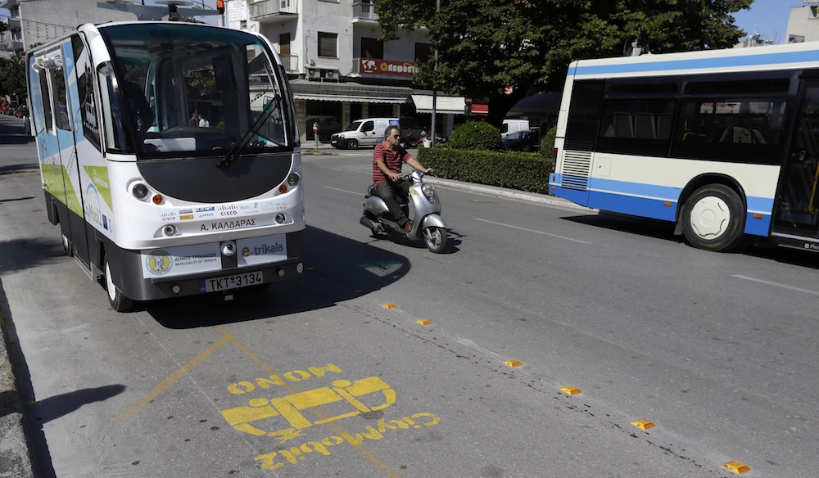
CityMobil2 Driverless bus in reserved lane
Helsinki, Finland
La Rochelle, France
Lausanne, Switzerland
Trikala, Greece

Slide 39
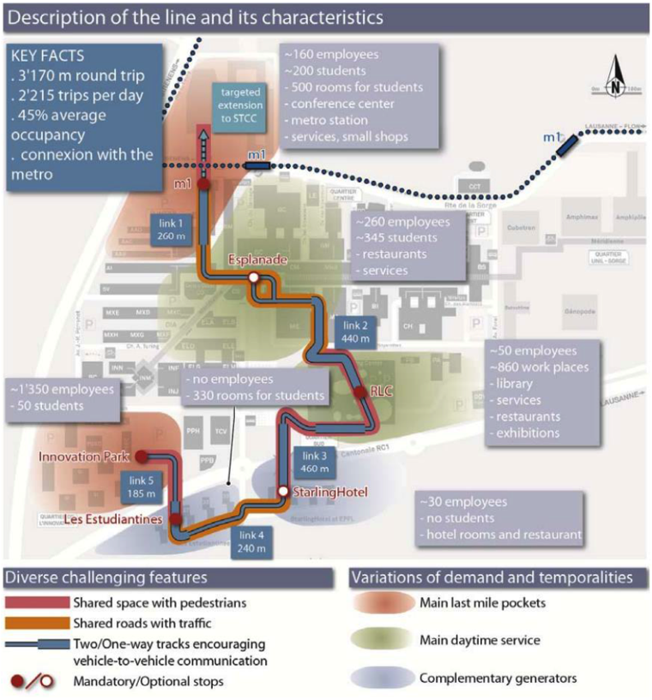
Transit Leap 1 example
EPFL, Switzerland | EasyMile
Environment | University Campus
Type of traffic | Ped, bike, low speed cars
Duration | Apr-Aug 2015
Track Length | 2.3 km
Number stops | 6
Number shuttles | 6
Passengers | +6,000
Hours | 07:45-20:00 daily

Slide 40
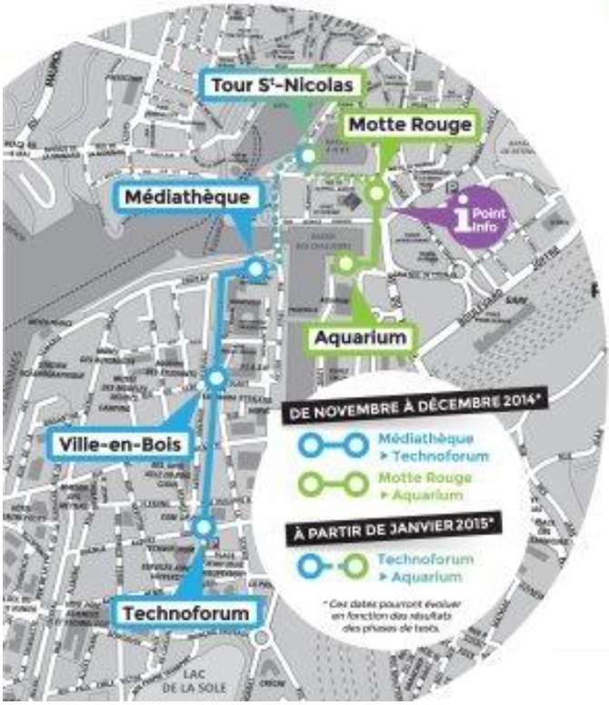
Transit Leap 1 example
La Rochelle, France | Robosoft
Environment | City Center
Type of traffic | Ped, bike, low speed cars
Duration | Dec 2014 Apr 2015
Track Length | 1.5 km
Number stops | 7
Number shuttles | 6
Passengers | +8,500
Hours | 10:00-17:00 daily

Slide 41
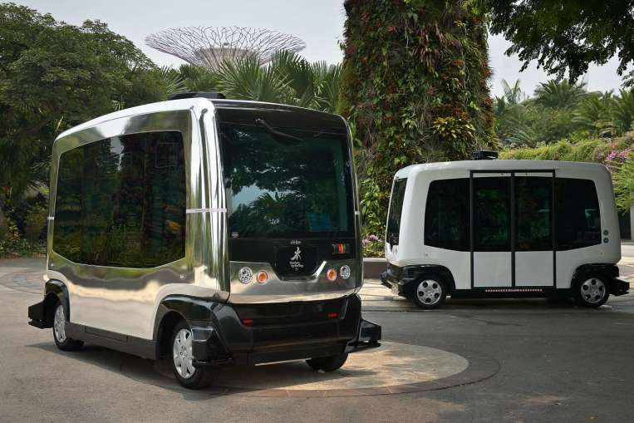
Singapore Autonomous Vehicle Initiative
Planning
fixed mass-transport services
on-demand shuttle services
freight transport
Utility (e.g., road sweeping)
http://www.lta.gov.sg/content/ltaweb/en/roads-and-motoring/managing-traffic-and-congestion/intelligent-transport-systems/savi.html
Notes:
Singapore Autonomous Vehicle Initiative

Slide 42
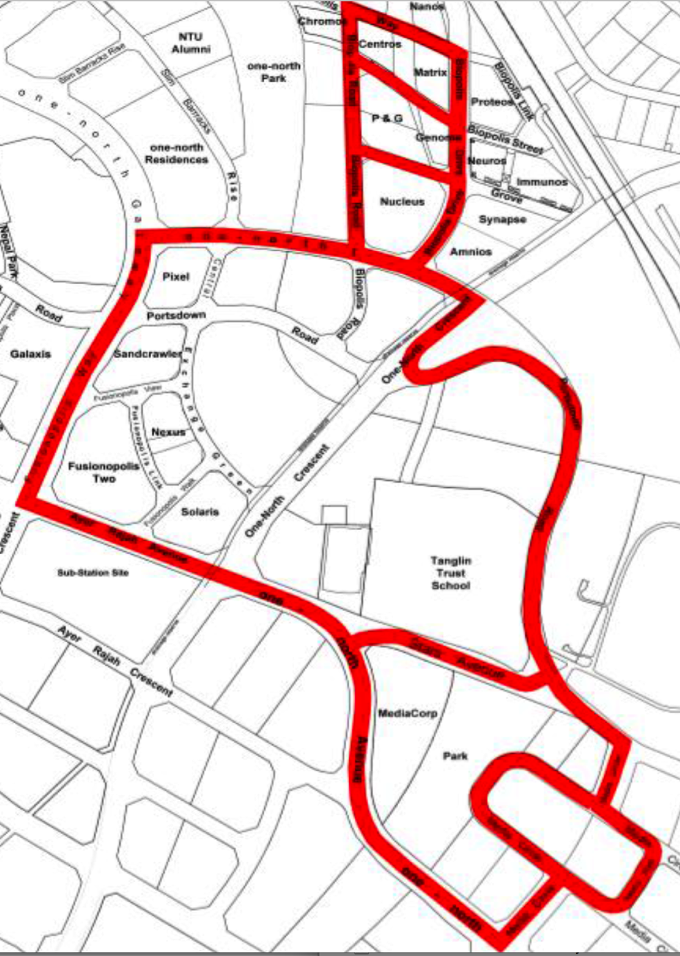
A Transit Leap 1 route in One-North
*
Singapore Autonomous Vehicle Initiative
(2km²)
Notes:
Singapore Autonomous Vehicle Initiative

Slide 43
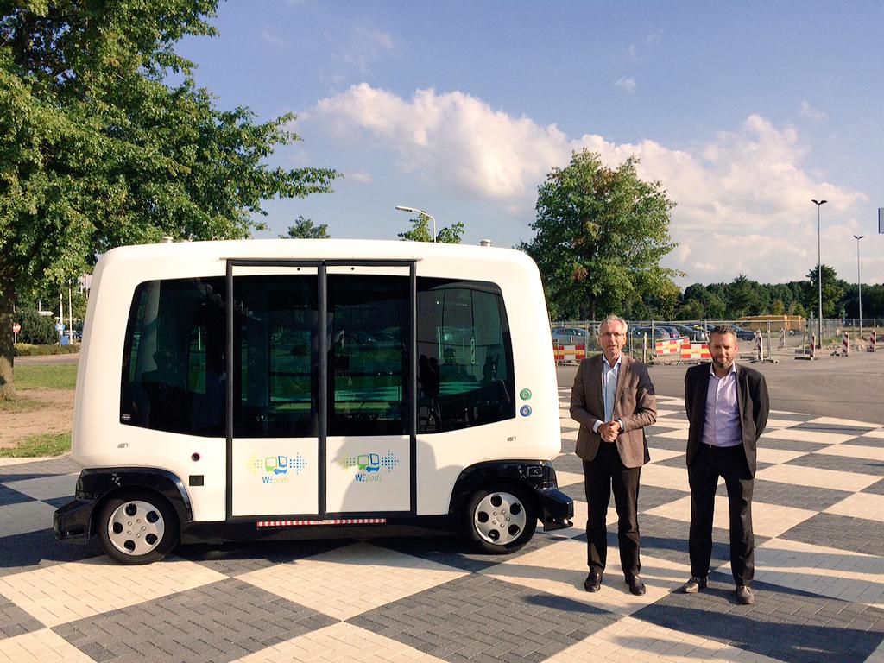
WEpod – The Netherlands
“First driverless buses travel public roads in Netherlands”
(The Telegraph, Jan 28, 2016)
Self-driving WEpod to move passengers on public roads among public traffic between Wageningen and Ede, about 11k apart; buses carry 6-12 people at 25 kph.
Notes:
Public road
There are several initiatives with selfdriving vehicles all over the world like the Rotterdam Rivium shuttle bus, the Heathrow shuttles, and the Masdar pods. However these vehicles operate on dedicated lanes. The Citymobil2 project is demonstrating selfdriving vehicles on public roads with a steward on board. The WEpods project will operate on public roads in mixed traffic. A control room will monitor vehicle operation and safety, and initially a steward may accompany the guests in the vehicle. WEpods will initially focus on a fixed route, and can be extended to new routes and to other regions in the Netherlands, providing a quality leap for public transport. From: http://davi.connekt.nl/wepods-project/
The test starts in November 2015 and will ferry students of Wageningen University to the Ede-Wageningen train station. During its test phase it will not travel in challenging conditions, such as in rush hour traffic, at night or in bad weather. A control room will monitor the vehicle and safety of its passengers.
People fret over 25kph, but the first flight by the Wright brothers — 852 feet — did not prove that airtravel would never work.

Slide 44


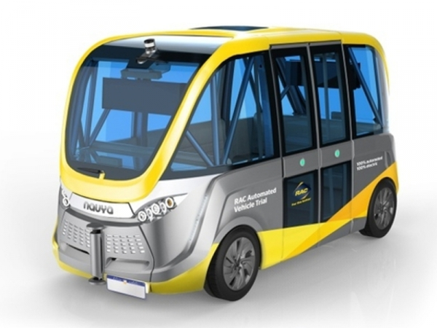
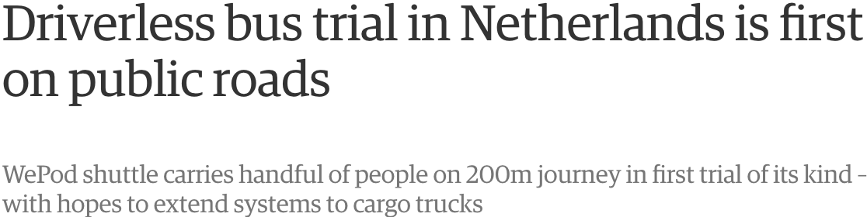

Slide 45
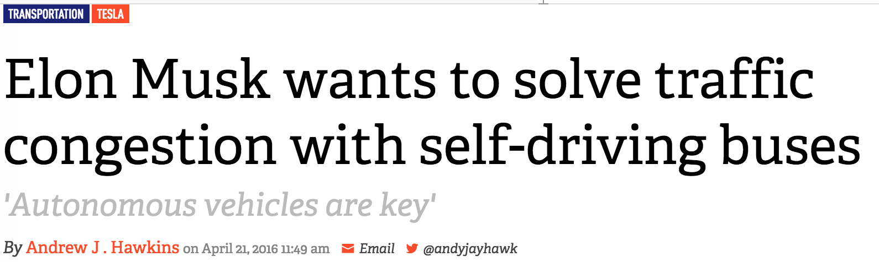
Urmson & Musk hint: autonomous bus
…and both admit Level 5 is farther off
© Grush Niles Strategic

Slide 46
The route to massive shared fleets
Create (don’t predict) the future we want
Respect the commercial, social and safety value of attention
Respect the wickedness of automobility
Use behavioral economics

Slide 47
Personal Public
Level 3
Conditional Automation
Level 5
Full Automation
2016-2035
Goes anywhere a licensed human can drive
Household/consumer use
(prefer over Level 5 due to access anxiety)
Operator in seat
Managed use
Constrained locations
  Scheduled operations
  Controlled situations
  Prepared routes
  Robocab | Robotransit
At first: stewards &
video surveillance

Slide 48
Bern Grush
bgrush@endofdriving.org
647 218 8600
Toronto | Seattle
Grush Niles Strategic
www.grushniles.com
@EndOfDriving
@TransitLeap
Recent http://endofdriving.org/publications/
Planning for transportation-as-a-service (2016) Ontario Planning Journal
Getting past the hype: revisited (2016) Connected Canada. ITS Canada
How cities can use autonomous vehicles to increase transit ridership and reduce household ownership. (2016) Canadian Transportation Research Forum (Runner-up: Best Conference Paper)
© Grush Niles Strategic

